Slide 1
Linux
Day 2

Slide 2
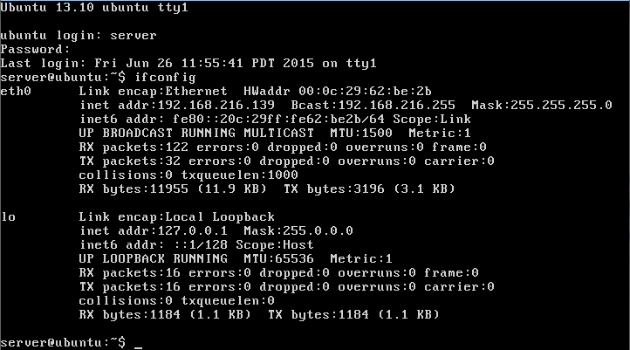
Find out your IP address
Simply type
‘ifconfig’ into the terminal.

Slide 3
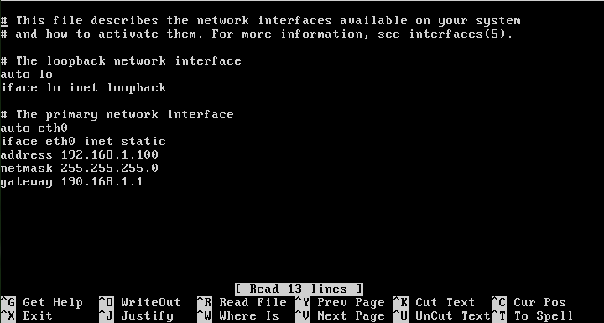
Configure a static IP address
Open /etc/network/interfaces. Change the dhcp to static and specify the details. Then restart the interface.

Slide 4
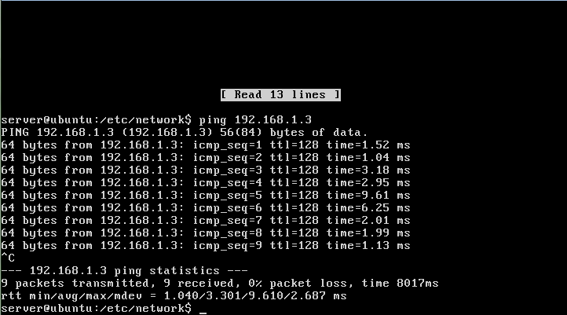
Configure the IP addresses of all the computers in your team within the same subnet
Now that we set the ip to the same subnet, we are able to ping other computers on the network.

Slide 5
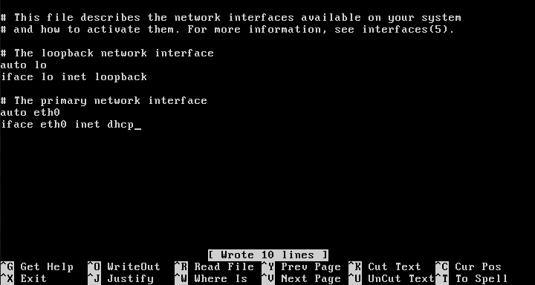
Configure so that your ubuntu image can get the IP address from the DHCP server
Go back to the same file etc/network/interfaces and change the static to dhcp and delete the information beneath it.

Slide 6
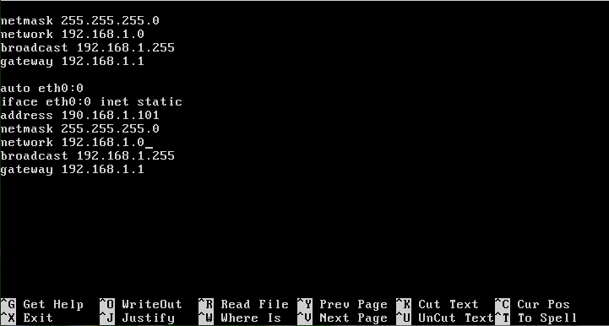
Set up multiple IP addresses on a single NIC card
Add in another interface entry, and use the same interface just add a :<number> to it.

Slide 7
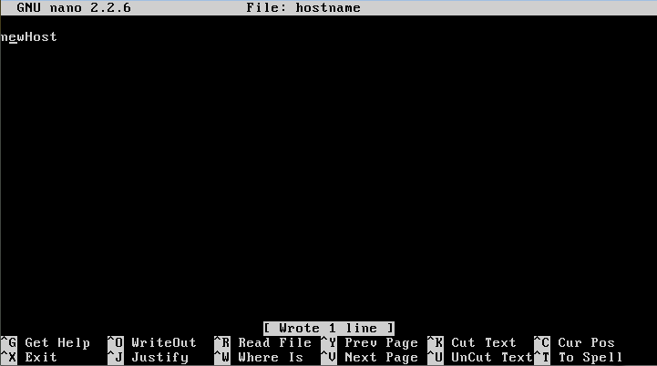
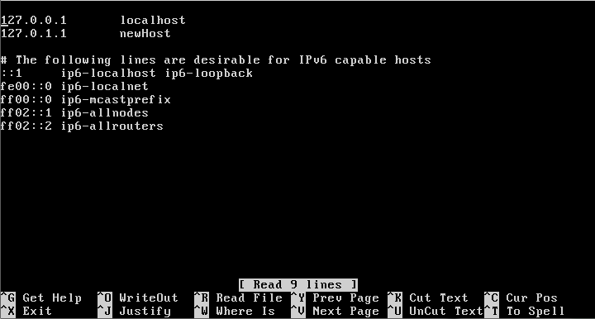
Change the hostname
Go to /etc/hostname and change the hostname. You also need to go to /etc/hosts and change the name there.

Slide 8
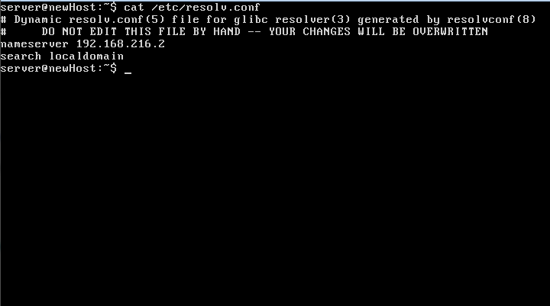
Find out the nameserver IP address
Use the command
cat /etc/resolv.conf
and it will list the nameservers and IPs.

Slide 9
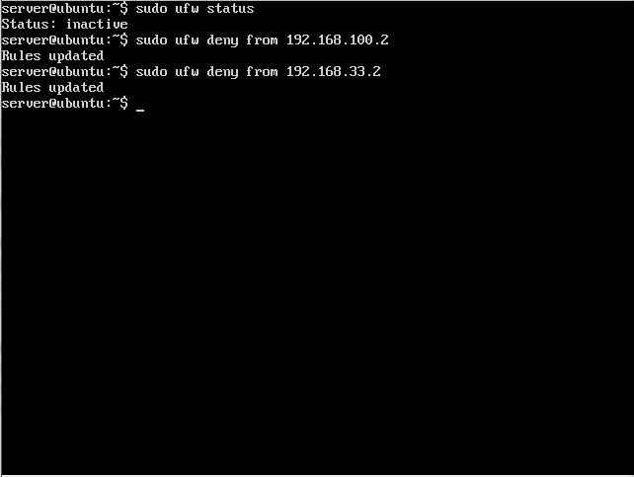
Deny any connection from host 192.168.55.2 and 192.168.33.2
Just use the command
sudo ufw from <IP>

Slide 10
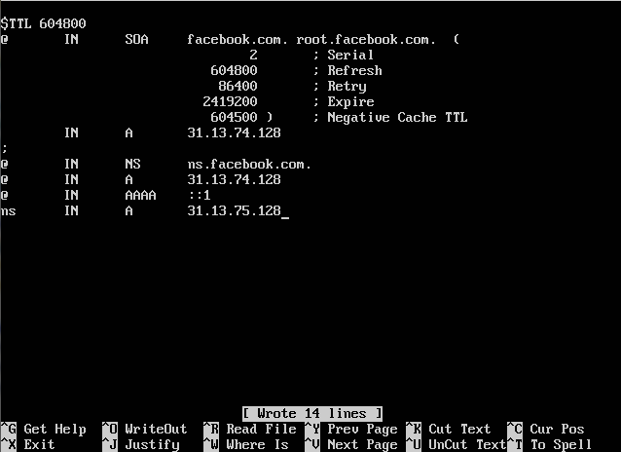
Add a DNS host
Copy the example file and change

Slide 11
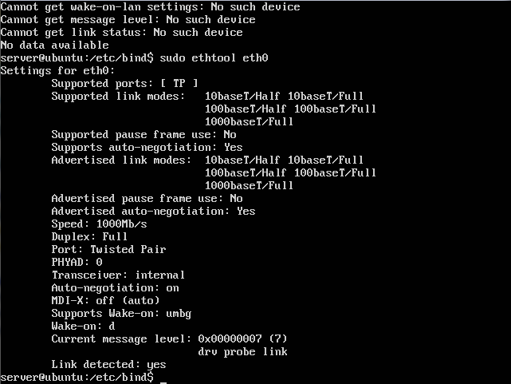
Find out whether the network interface has the following configurations:
Duplex (full or not), Auto-negotiations (on or off)
Find out the speed of the network interface
The command
‘sudo ethtool <interface>’ will give the speed and duplex configurations.

Slide 12

Find out any route that are configured by default in your ubuntu image
netstat -rn or route -n

Slide 13
Add permanent static routes to network 192.168.50.0/24 via gateway 192.168.1.254.
ip route add {NETWORK} via {IP} dev {DEVICE}

Slide 14
Add a permanent static route to host 192.168.40.99 via gateway 192.168.1.254.
route add -host {NETWORK} gw {GATEWAY}

Slide 15

Verify the status of firewall. If turned off, turn it on.
ufw status verbose
ufw enable

Slide 16
Find out the version of ufw.
According to the Ubuntu Wiki our version 14.04.2 of Ubuntu Server comes with version 0.34~rc-0ubuntu2 of UFW

Slide 17

Deny all default incoming connections.
ufw default deny incoming

Slide 18

Allow all default outgoing connections.
ufw default deny outgoing

Slide 19

Allow incoming ssh connections.
ufw allow ssh

Slide 20

Allow incoming ftp connections.
ufw allow ftp

Slide 21

Allow tcp to run on ports from 4400 to 5500.
ufw allow 4400:5500/tcp

Slide 22

Allow incoming http connections.
ufw allow http

Slide 23

Do not allow tcp connections from 192.168.1.5 and 192.168.6.2.
ufw deny from {IP} proto tcp
This denies any tcp connections from the two IPs

Slide 24
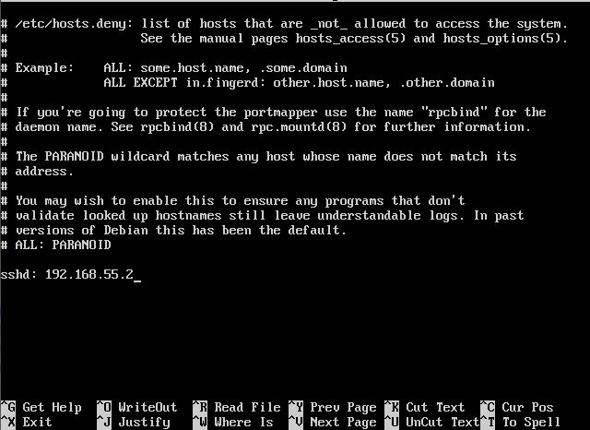
Do not allow ssh connections from 192.168.100.0/24.
Go into the hosts.deny file in etc and add a ssh entry and list the IP

Slide 25

Turn on logging to high.
ufw logging LEVEL

Slide 26
Find the runlevel you are logged on as.
runlevel
The ‘N' stands for none, meaning there has been no run level change since powering up.
And ‘2’ means Full multi-user mode (which is the default)

Slide 27
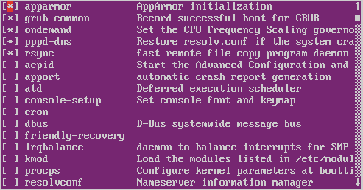

List the services that start up automatically on your desktop
apt-get install rcconf
sudo rcconf

Slide 28
Restart networking service
/etc/init.d/networking restart

Slide 29
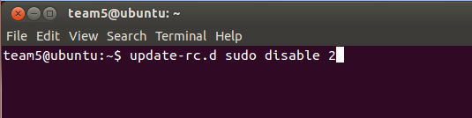
Change the sudo service in your run level so that it does not start on startup.
To disable any service for a certain runlevel use the command shown to the right.
The 2 at the end is which runlevel you want to enable/disable the service for, my runlevel is 2.

Slide 30
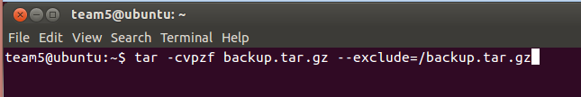
Backup the /home directory.
Backing up files in ubuntu uses the tar command.
To the right is an example
of this command.
-c creates a new backup archive
-v sets verbose mode, so tar explains what it’s doing
-p preserves the permissions when each file is restored
-z compresses the backup file with gzip, which makes it smaller
-f <filename> names the file that the backup will be stored in, with this example using backup.tar.gz
--exclude=<path> gives the backup a file to exclude, here we exclude the backup itself as this can cause issues with the backup

Slide 31

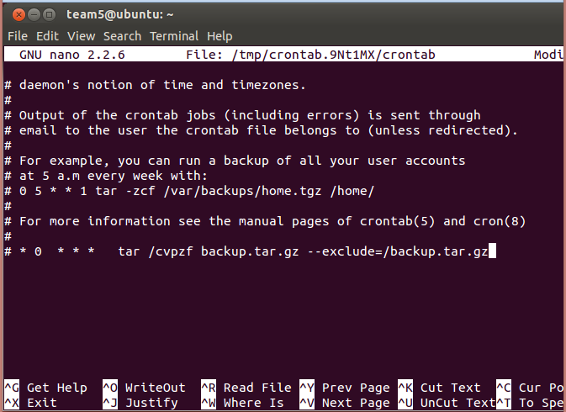
Create cron jobs to create backup for each user’s home directory. Backup should be done every day at 12.00 AM.
Cron is a way to tell your system to perform a task at any given time. This is especially helpful for tasks that must be done repeatedly, say every week.
Start a new Cron Job by using the command “Crontab -e”
Then go to the bottom of the file and add the line in the red box.
Those asterisks and the 0 tell when to perform the command to backup. The first space is for the minute, then the hour, then the day of the week, day of the month, and finally the month itself.
* stands in for when every option is used

Slide 32
Resources
https://help.ubuntu.com/community/
http://ubuntuforums.org/
https://askubuntu.com/

